Slide 1

Kerberos & certificates
We have access, now what?
Nathan Ord

Slide 2
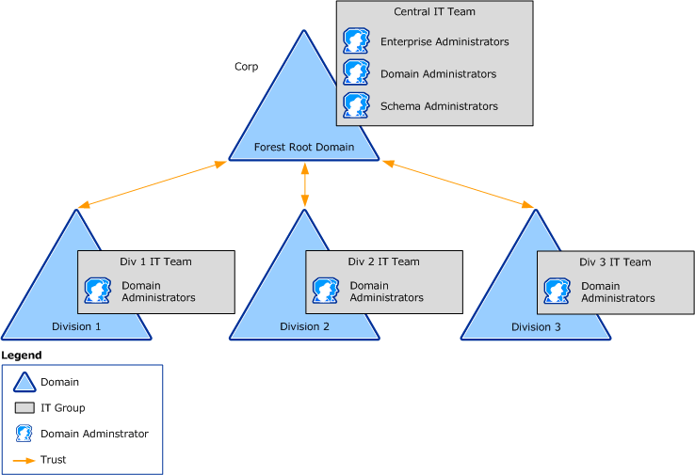

Big ideas
Initial Access in a Windows environment
Lateral movement in a Windows environment
Long term persistence w/o C2
Non-Domain Joined Host

Slide 3

What is Kerberos?
Introduced in 1987/8 [1]
Kerberos is Microsoft’s replacement for NTLM authentication
  Used for users and hosts [2]
Uses a ticketing system
Better security than NTLM [3]
Single Sign-On
Multiple Platforms
https://web.mit.edu/Saltzer/www/publications/Kerberosorigin.pdf
https://learn.microsoft.com/en-us/windows-server/security/kerberos/kerberos-authentication-overview
https://www.geeksforgeeks.org/computer-networks/difference-between-kerberos-and-ntlm/
https://web.mit.edu/Kerberos/#what_is

Slide 4
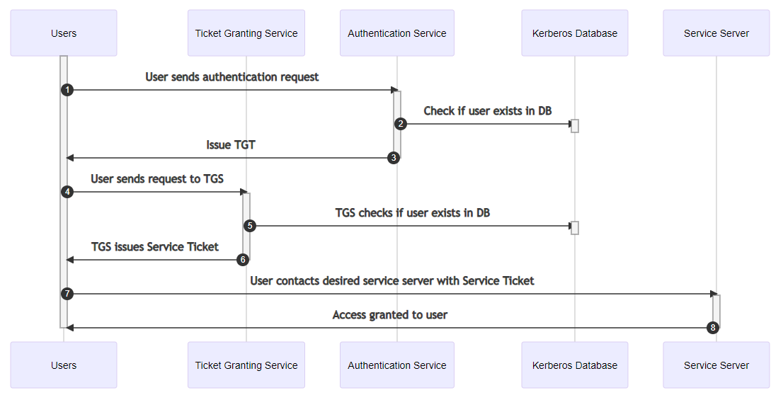
How does Kerberos work?
Ok so tickets…
https://www.freecodecamp.org/news/how-does-kerberos-work-authentication-protocol/

Slide 5
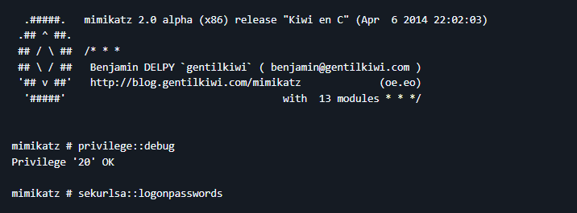
What tools do we use?
Rubeus - https://github.com/GhostPack/Rubeus
Mimikatz - https://github.com/ParrotSec/mimikatz
Others…

Slide 6
GAINING ACCESS W/ TICKETS
DEMO

Slide 7
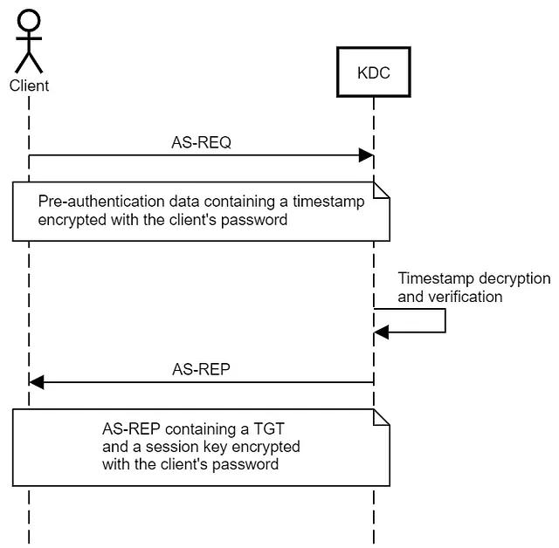
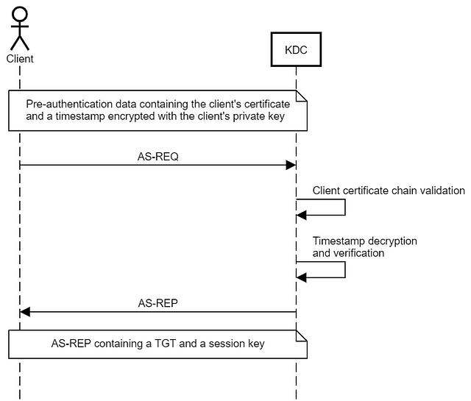
What now?
Passwords change; hashes change…so what are our options?
Public Keys!
https://specterops.io/blog/2021/06/17/shadow-credentials-abusing-key-trust-account-mapping-for-account-takeover/

Slide 8
What tools do we use?
Whisker - https://github.com/eladshamir/Whisker
pyWhisker –
https://github.com/ShutdownRepo/pywhisker

Slide 9
Using certificates for access
DEMO

